Slide 1

Early Prediction for Heart Disease
Presented by: Team BMC AI

Slide 2
Outline:
Problem Definition
Approaches
Interpreting Models
Result
Conclusion

Slide 3
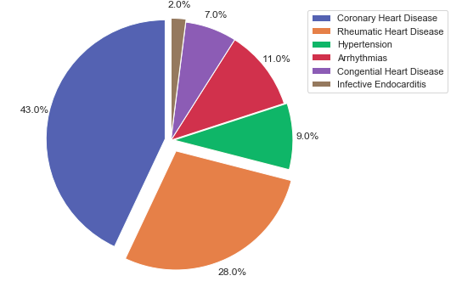
Problem Definition
Percentage of heart disease patient in Nepal
Source: www.clinicone.com.np(WHO)

Slide 4
Problem Definition
Percentage of heart disease patient in Nepal
Heart Disease Death rate is 12.26% of total death in Nepal.
Source: www.clinicone.com.np(WHO)

Slide 5
Problem Definition
Percentage of heart disease patient in Nepal
Heart Disease Death rate is 12.26% of total death in Nepal.
In Tribhuvan University Teaching Hospital ,out of 20% patients are heart disease
Source: www.clinicone.com.np(WHO)

Slide 6
Problem Definition
Percentage of heart disease patient in Nepal
Heart Disease Death rate is 12.26% of total death in Nepal.
In Tribhuvan University Teaching Hospital ,out of 20% patients are heart disease
The Nepalgunj Teaching Hospital, which mainly serves the western hilly district, sees 20-40 patients of heart disease daily.
Source: www.clinicone.com.np(WHO)

Slide 7
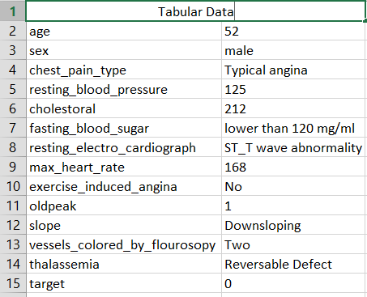
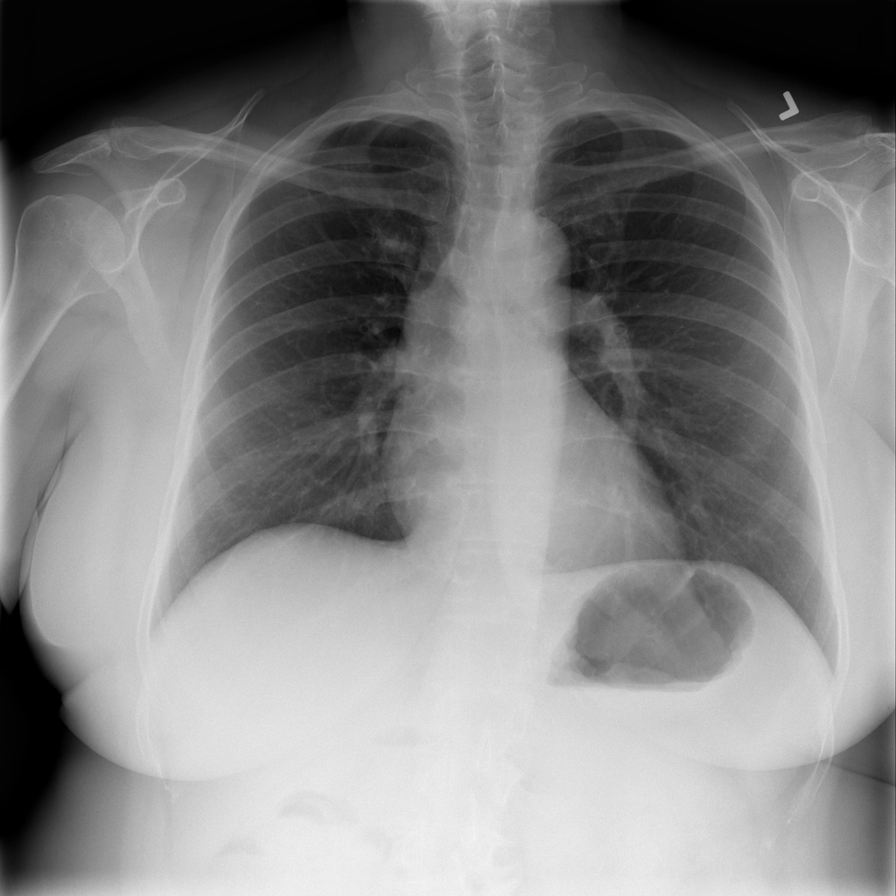
Fig: Tabular Data
Fig: Chest X-ray

Slide 8
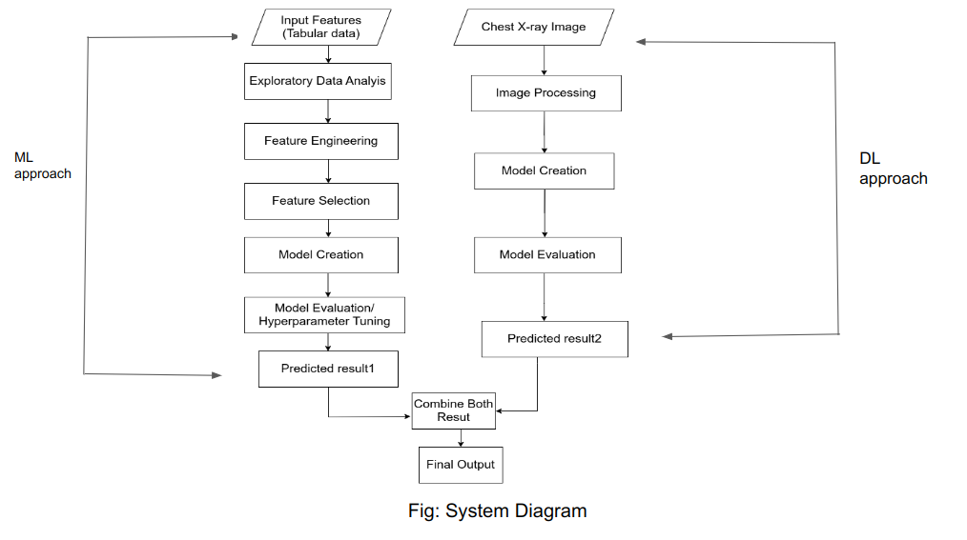

Slide 9
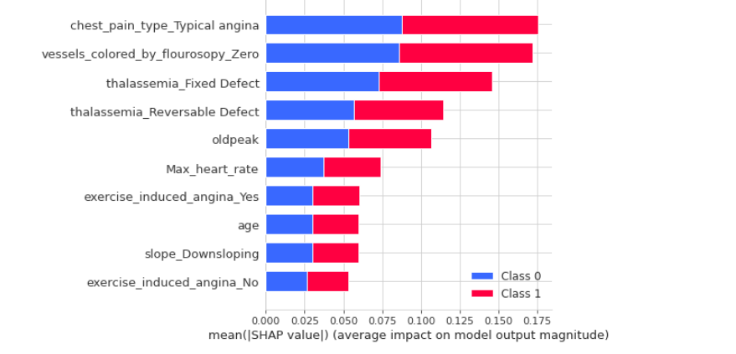
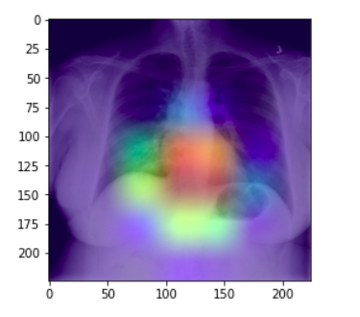
Interpreting ML model
Interpreting DL Model

Slide 10
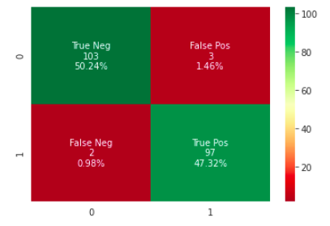
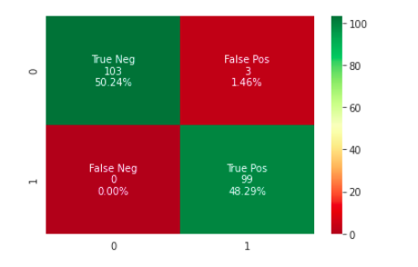
ML Model(Random Forest)
After Hyperparameter Tuning
Actual result
Actual result
Predicted result
Predicted result

Slide 11
Conclusion:
We can offer this system to the Nepal government for use in rural areas such as district hospital and health posts
We can provide this system to private hospitals, individual clinics and other organization who have their own doctors.
If there are limited number of doctors in rural areas and machines are available, this system would be more effective and could also be used in cities.

Slide 12
Further works:
Domain Expert such as cardiologists.
Demographic dataset (i.e data of heart disease patient from Nepal)

Slide 13
Thank You!!

Slide 14
